Slide 1

Introduction to Cyberbullying Detection
Presented By:
Revanth Paineni
Sridhar Yemundla

Slide 2
Data Collection
Dataset Source: Utilizes the "Cyberbullying Tweets" dataset from Kaggle.
Content Details: Dataset comprises various categories of cyberbullying, including remarks on gender, ethnicity, and age.
Data Preparation: Text data preprocessing includes cleaning, tokenization, stemming, and removal of stopwords for cleaner, more uniform input data.

Slide 3

Model Architectures Overview
GRU-based Model: Employs a GRU layer to capture temporal dependencies in text data effectively, handling sequences for dynamic text length.
CNN-based Model: Uses Conv1D layers with spatial dropout and batch normalization to extract robust feature maps from sequences.
BERT-based Model: Incorporates a pre-trained BERT model fine-tuned on the cyberbullying data to leverage deep contextual embeddings.

Slide 4

Text Preprocessing and Feature Engineering
Initial Cleaning: Removes URLs, user mentions, and hashtags to focus on meaningful text content.
Vectorization: Texts are converted into numerical data using Tokenizer and padded to uniform sequence lengths for model input.
Embedding: Uses GloVe pretrained vectors to transform words into a 200-dimensional semantic space, enriching the model's understanding of language nuances.

Slide 5

Training Process
Optimization: Adam optimizer with specific learning rates tailored to each model architecture to enhance convergence.
Loss Function: Categorical crossentropy to measure performance across multiple class outputs.
Regularization Techniques: Dropout and recurrent dropout in GRU; spatial dropout in CNN to prevent overfitting.

Slide 6

Evaluation and Metrics
Metrics Utilized: Accuracy, Precision, Recall, and F1 Score to comprehensively assess model performance.
Model Comparison: Evaluates how each architecture performs on the training and validation datasets, focusing on metric scores and loss reduction.

Slide 7
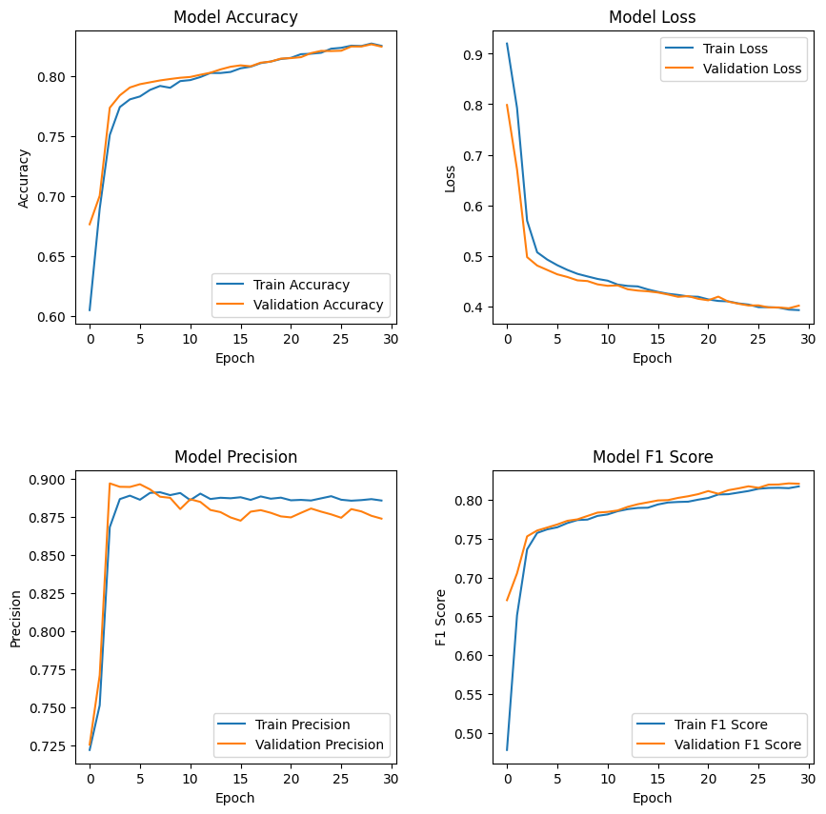
Training Results Visualization
Graphical Analysis: Plots of accuracy, loss, precision, and F1 Score for each model to illustrate learning effectiveness and model stability over epochs.
Model Selection: Based on performance metrics, recommend the most effective model for deployment in operational environments.

Slide 8

Conclusion
Achievements:
Comprehensive Model Implementation: Implemented a range of models including LSTM, GRU, CNN, and BERT for automatic text summarization and classification tasks.
Advanced Preprocessing and Tokenization: Employed sophisticated text preprocessing techniques and tokenization to enhance model input quality.
Key Insights:
Model Diversity: Demonstrated the effectiveness of various neural network architectures in handling complex NLP tasks, providing robust solutions for cyberbullying detection and other text-based classifications.
Evaluation Metrics: Utilized a combination of accuracy, precision, recall, and F1 scores to comprehensively evaluate model performance, ensuring a thorough validation of model predictions.

